Slide 1
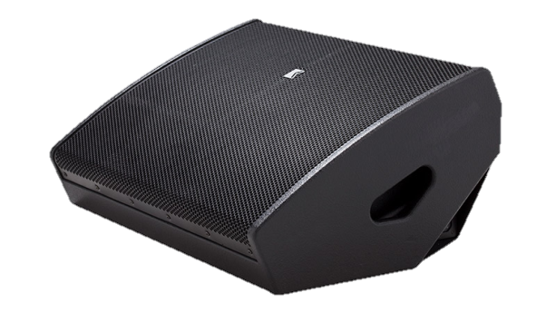
MONITOR SPEAKER
iSM 212 (Outline)
자체 전원 웨지 모니터 스피커
전용 iPad 앱을 통해 제어 가능
바이 앰프 프로세서 및 앰프를 포함 하고도 32kg로 작고 가벼움
SPECIFICATION
FREQUENCY RESPONSE(-10 dB) | 64 Hz – 18 kHz
AVERAGE DISPERSION | 30° x 50° (H x V)
ON-AXIS ANGLE | 65° related to ground
Power Amplifier | Type: Class D (digital) Input impedance: 10 kΩ balanced to ground Rated power: 1 x 1050 W EIAJ on 8 Ω, 1 x 570 W EIAJ on 16 Ω Cooling: temperature controlled variable speed fan Special feature: direct preset selection, controllable via iPad app
MAXIMUM SPL OUTPUT | 143 dB SPL
LOUDSPEAKERS AND LOADING | Low : 2 x 12″ NdFeB woofer, vented high-pass box High: 3″ diaphragm compression driver with folded waveguide
WEIGHT – SINGLE UNIT | 32 kg – 70.5 lb
DIMENSIONS | 325 mm – 12 3/4″ 700 mm – 27 1/2″ 500 mm – 19 3/4″

