Slide 1
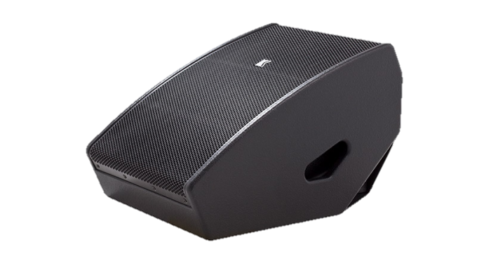
MONITOR SPEAKER
iSM 115 (Outline)
자체 전원 웨지 모니터 스피커
전용 iPad 앱을 통해 제어 가능
바이 앰프 프로세서 및 앰프를 포함 하고도 27.5kg작고 가벼움
SPECIFICATION
FREQUENCY RESPONSE(-10 dB) | 59 Hz – 18 kHz
AVERAGE DISPERSION | 40° x 60° (H x V)
ON-AXIS ANGLE | 65° related to ground
Power Amplifier | Type: Class D (digital) Input impedance: 10 kΩ balanced to ground Rated power: 1 x 750 W EIAJ on 4 Ω, 1 x 370 W EIAJ on 8 Ω Cooling: temperature controlled variable speed fan Special feature: direct preset selection, controllable via iPad app
MAXIMUM SPL OUTPUT | 139 dB SPL
LOUDSPEAKERS AND LOADING | Low : 1 x 15″ NdFeB woofer, vented high-pass box High: 2.5″ diaphragm compression driver with folded waveguide
WEIGHT – SINGLE UNIT | 25 kg – 55.1 lb
DIMENSIONS | 395 mm – 15 1/2″ 450 mm – 17 3/4″ 610 mm – 24″

