Slide 1
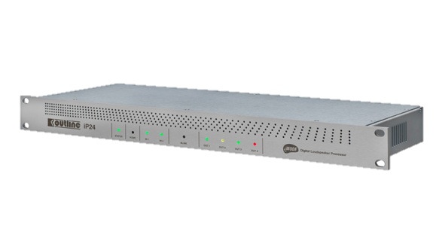
PROCESSOR
iP24 (Outline)
2 IN / 4 OUT 아날로그 및 디지털 구성
2개의 이더넷 포트
인간의 귀와 동일한 원리인 WFIR 필터
SPECIFICATION
FREQUENCY RESPONSE | 20 Hz – 20 kHz (± 0.5 dB)
INPUT SENSITIVITY | +10 dBu, +20 dBu remotely selectable
SAMPLE RATE | 96 kHz
THD + N | 147.5 dB SPL
NOISE OUTPUT LEVEL | -95.5 dBu (unweighted)
COMMUNICATIO | Ethernet standard (TCP/IP)
CONNECTORS | 2 x analog input XLR 4 x analog output XLR 1 x AES3 input XLR 2 x AES3 output XLR 2 x ethernet port 1 x DB9 general input / output port 1 x RS485 port
WEIGHT | 1.6 kg – 3.5 lb
DIMENTION | Height : 45 mm – 1 3/4″ Width : 483 mm – 19″ Depth : 475 mm – 18 3/7″

