Slide 1
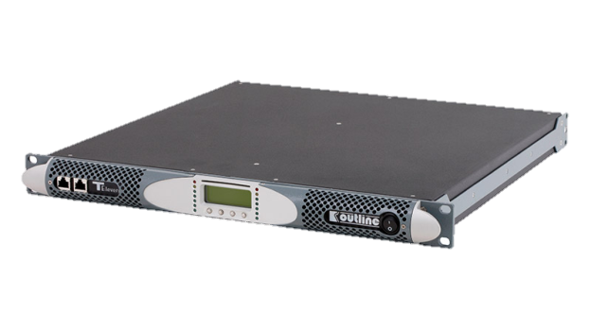
POWER AMPLIFIER
T ELEVEN (Outline)
내장형 원격 제어(RS 485 인터페이스)
스마트 카드로 셋팅 및 업그레이드 가능
DSP 옵션 기능
이더넷 옵션 기능
SPECIFICATION
NUMBER OF CHANNELS | 2
OUTPUT POWER(PER CHANNEL) | Single channel mode: 6000 W @ 2 Ω, 4000 W @ 4 Ω, 2000 W @ 8 Ω Bridge mode: 12000 W @ 4 Ω, 8000 W @ 8 Ω
GAIN | Selectable: 26 dB, 29 dB, 32 dB, 35 dB
FREQUENCY RESPONSE | 20 Hz – 20 kHz (±0.5 dB) @ 1 W, 8 Ω
S/N RATIO | > 110 dB (20 Hz – 20 kHz, A-weighted)
CROSSTALK SEPARATION | > 66 dB @ 1kHz
INPUT IMPEDANCE | 10 kΩ balanced
SLEW RATE | 50 V/μs @ 8 Ω, input filter bypassed
WEIGHT | 12 kg – 26.5 lb
DIMENTION | Height : 45 mm – 1 3/4″ Width : 483 mm – 19″ Depth : 475 mm – 18 3/7″

