Slide 1
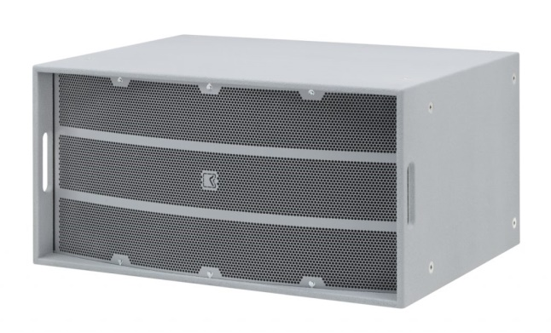
STADIUM SPEAKER
STSUB-215 (Outline)
STADIA의 저음을 채워주는 서브우퍼
매우 높은 효율의 전력처리성능
2 bass-reflex loaded 15 "네오디뮴 우퍼
16개의 M10 리깅 포인트 장착
SPECIFICATION
FREQUENCY RESPONSE(-10 dB) | 34 Hz – 2.4 kHz
SUGGESTED CROSS-OVER | max 150 Hz
IMPEDANCE | 2 x 8 Ω / 2 x 6.7 Ω
POWER – W AES | 2 x 600 W / 2 x 2400 W
MAXIMUM SPL OUTPUT SPL | 144 dB SPL
LOUDSPEAKERS AND LOADING | 2 x 15” direct radiation woofers
WEIGHT – SINGLE UNIT | 50 kg – 112.4 lb
DIMENSIONS | Height: 480 mm – 18 57/64” Width: 700 mm – 27 9/16” Depth: 940 mm – 37”

