Slide 1
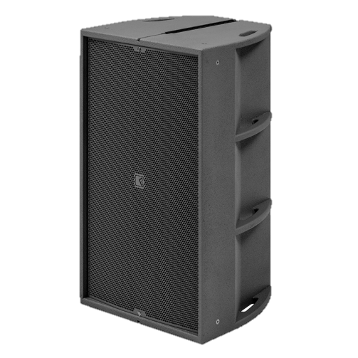
POINT SOURCE SPEAKER
MONACO 215 CX SP (Outline)
강력한 풀 레인지 인클로저
동축 HF의 장점을 유지하며 우퍼의 영향을 최대화
2-way 바이 앰핑, 4개의 프리셋 내장
회전 가능한 HF 혼
SPECIFICATION
FREQUENCY RESPONSE(-10 dB) | 50 Hz – 20 kHz
AVERAGE DISPERSION | 80° x 60° (H x V)
Power amplifier | Type: Class D (digital) Input impedance: 4.5 kΩ balanced Rated power: 2 x 1500 W EIAJ at 8 Ohm Cooling: Cooling Tunnel + Variable Speed Fan Special feature: selectable input gain and preset
MAXIMUM SPL OUTPUT | 140 dB SPL
LOUDSPEAKERS AND LOADING | Low : 15″ woofer Coaxial Low : 15” woofer Coaxial High : 3″ diaphragm compression driver
WEIGHT – SINGLE UNIT | 42 kg – 92.6 lb
DIMENSIONS | Height: 940 mm – 37” Width: 480 mm – 18 7/8” Depth: 480 mm – 18 7/8”

