Slide 1
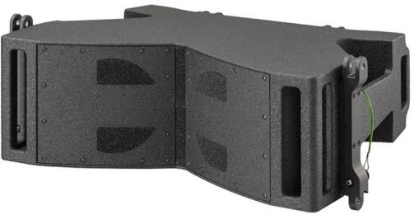
LINEARRAY SPEAKER
MANTAS 28 (Outline)
중음 및 고주파 재생을 위한 라인어레이
작은 크기대비 큰 SPL
GTO의 아래에 리깅 가능
DPRWG 압축 드라이버
SPECIFICATION
FREQUENCY RESPONSE(-10 dB) | 90 Hz – 18 kHz
AVERAGE DISPERSION | Horizontal: 120° Vertical: Array design dependent
IMPEDANCE | Mid: 8 Ω / 6.4 Ω High: 8 Ω / 8.4 Ω
POWER – W AES | Mid: 400 W / 1600 W High: 110 W / 440 W
MAXIMUM SPL OUTPUT | 139 dB SPL
LOUDSPEAKERS AND LOADING | Mid: 2 x 8” NdFeB partially horn loaded mid woofer High: 1 x 3” diaphragm NdFeB compression driver, DPRWG loaded
WEIGHT – SINGLE UNIT | 24 kg – 52.9 lb
DIMENSIONS | Height: 278 mm – 11” Width: 756 mm – 29 3/4” Depth: 518 mm – 20 3/8”

