Slide 1
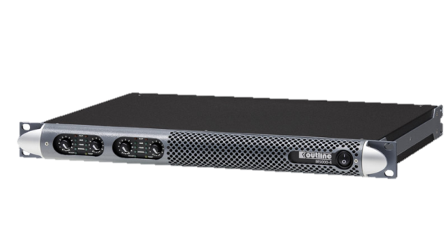
POWER AMPLIFIER
M 5000-4 (Outline)
최대 5000W를 제공하는 1U 4채널 앰프
1/2와 3/4 사이에 브리지 모드 작동
4옴에 최적화 됨
변압기 없이 직접 100V 구동
SPECIFICATION
NUMBER OF CHANNELS | 4
OUTPUT POWER(PER CHANNEL) | Single channel mode: 1250 W @ 4 Ω, 750 W @ 8 Ω Bridge mode: 2500 W @ 8 Ω Distributed line*: 1000 W @ 70 V, 1250 W @ 100 V
GAIN | 32 dB, 30 dB, 28 dB, 26 dB, 24 dB, 22 dB, 20 dB, 18 dB, 14 dB, 4 dB, -∞, user selectable
FREQUENCY RESPONSE | 20 Hz – 20 kHz (±0.5 dB) @ 1 W, 8 Ω
S/N RATIO | > 110 dB (20 Hz – 20 kHz, A-weighted)
CROSSTALK SEPARATION | > 70 dB @ 1kHz
INPUT IMPEDANCE | 10 kΩ balanced
SLEW RATE | 50 V/μs @ 8 Ω, input filter bypassed
WEIGHT | 7.4kg – 16.3Ib
DIMENTION | Height : 45 mm – 1 3/4″ Width : 483 mm – 19″ Depth : 358 mm – 14 1/8″

