Slide 1
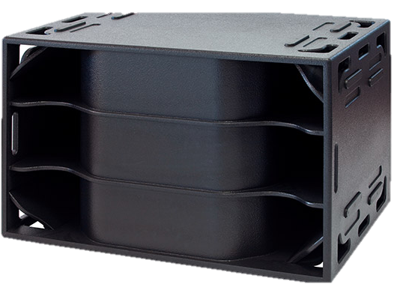
SUBWOOFER SPEAKER
LAB 21 HS (Outline)
21” 싱글 우퍼
매우 높은 전력 처리
세계에서 가장 작고 가벼운 21인치 서브우퍼
매우 높은 SPL
SPECIFICATION
FREQUENCY RESPONSE(-10 dB) | 23 Hz – 165 Hz
AVERAGE DISPERSION | Horizontal: Quasi-omnidirectional
IMPEDANCE | 4 Ω (min 4.3 Ω)
POWER – W AES | 2000 (8000 peak)
MAX SHORT-TERM SPL | 147 dB SPL (half-space)
LOUDSPEAKERS AND LOADING | 1 x 21″ NdFeB woofer, hybrid waveguide indirect radiation system
WEIGHT – SINGLE UNIT | 125 kg (275.5 lb)
DIMENSIONS | Height: 726 mm (28 19/32″) Width: 1126 mm (44 11/32″) Depth: 820 mm (32 9/32″)

