Slide 1
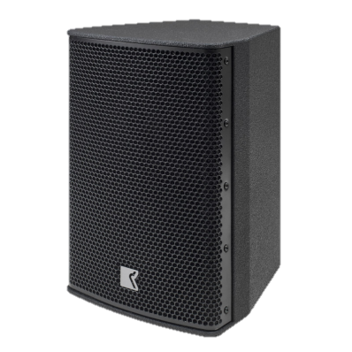
POINT SOURCE SPEAKER
IS 8 (Outline)
모든 범위에서 플랫한 주파수 응답특성
Ferrofluid 냉각 트위터
높은 감도와 낮은 캐비닛 공진
SPECIFICATION
FREQUENCY RESPONSE(-10 dB) | 45 Hz – 22.5 kHz
AVERAGE DISPERSION | 150° x 140° (H x V)
IMPEDANCE | 8 Ω (min 6.5 Ω)
POWER – W AES | 80 W(320W peak)
MAXIMUM SPL OUTPUT | 120 dB SPL
LOUDSPEAKERS AND LOADING | Low: 1 x 8″ High pass Vented box High: 1 x 1″ Dome tweeter
CONNECTORS | Wire clamp input terminals. Push Button Press Release connector. Red = + Black = –
WEIGHT – SINGLE UNIT | 7 kg (15.4 lb)
DIMENSIONS | Height: 415 mm (16 3/8″) Width: 260 mm (10 1/4″) Depth: 285 mm (11 1/4″)

