Slide 1
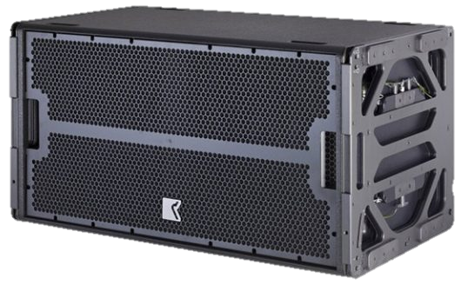
SUBWOOFER SPEAKER
GTO-SUB (Outline)
Grand Touring Outline
GTO 시리즈 초저음 보강
매우 높은 전력 처리 및 음압
경량의 GTO 시스템으로 최대 16개 플라잉
SPECIFICATION
FREQUENCY RESPONSE(-10 dB) | 28 Hz – 160 Hz
AVERAGE DISPERSION | Horizontal: Quasi-omnidirectional Vertical: Depending on array configuration
IMPEDANCE | 2 x 8 Ω (min 2 x 6.2 Ω
POWER – W AES | 2 x 1200 (2 x 4800 peak)
MAX SHORT-TERM SPL | 141 dB SPL (free-field) 147 dB SPL (half-space)
LOUDSPEAKERS AND LOADING | 2 x 18″ hybrid band-pass loaded woofers
WEIGHT – SINGLE UNIT | 102 kg (225 lb)
DIMENSIONS | Height: 600 mm (23 5/8″) Width: 1181 mm (46 1/2″) Depth: 655 mm (25 25/32″)

