Slide 1
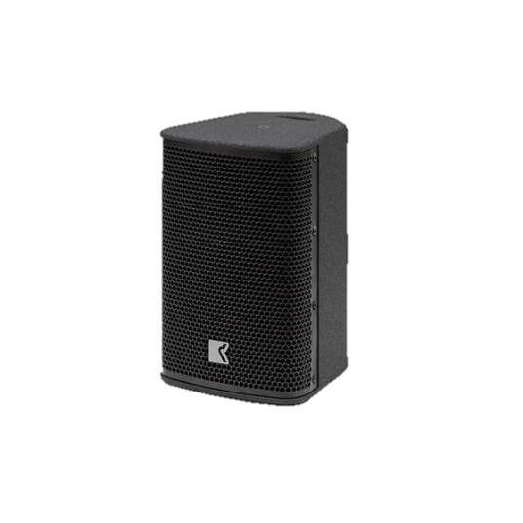
POINT SOURCE SPEAKER
EIDOS 6.5 (Outline)
높은 SPL
높은 음성 명료도
다양한 마운팅 포인트
SPECIFICATION
Frequency Response (-10 dB) | 65 Hz – 19 kHz
Nominal Dispersion | 100° x 60° (H x V)
Impedance (Nom/Min) | 8 Ω / 6.7 Ω
Watt AES (Continuous/Peak) | 200 W / 800 W
Maximum SPL Output * | 122 dB SPL
COMPONENT | Low : 6.5” woofer , Bass-reflex High : 1” diaphragm compression Driver Moulded horn
WEIGHT | 7.5 kg – 16.5 lb
DIMENSIONS | Height: 350 mm Width: 220 mm Depth: 245 mm

