Slide 1
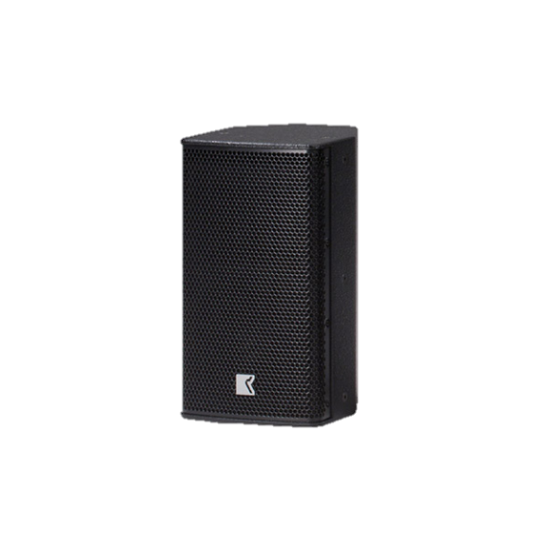
POINT SOURCE SPEAKER
DVS 8P SP (Outline)
다용도의 광범위한 자체 전원 시스템
내장 2 채널 DSP 제어 증폭기가 있는
2-way
조정 가능한 입력 게인
4개의 선택 가능한 EQ 프리셋
SPECIFICATION
FREQUENCY RESPONSE(-10 dB) | 48 Hz –18.5 kHz
AVERAGE DISPERSION | 90° x 60° (H x V)
POWER AMPLIFIER | Type: Class D (digital) Input impedance: 10 kΩ balanced to ground Rated power: 1 x 350 W EIAJ on 4 Ω (Low), 1 x 180 W EIAJ on 8 Ω (High) Cooling: natural air convection Special feature: selectable input gain and preset
MAXIMUM SPL OUTPUT | 127 dB SPL
LOUDSPEAKERS AND LOADING | Low : 8″ woofer High: 1″ diaphragm compression driver
WEIGHT – SINGLE UNIT | 9 kg – 19.8 lb
DIMENSIONS | Height: 420 mm – 16 1/2″ Width: 234 mm – 9 1/4″ Depth: 260 mm – 10 1/4″

