Slide 1
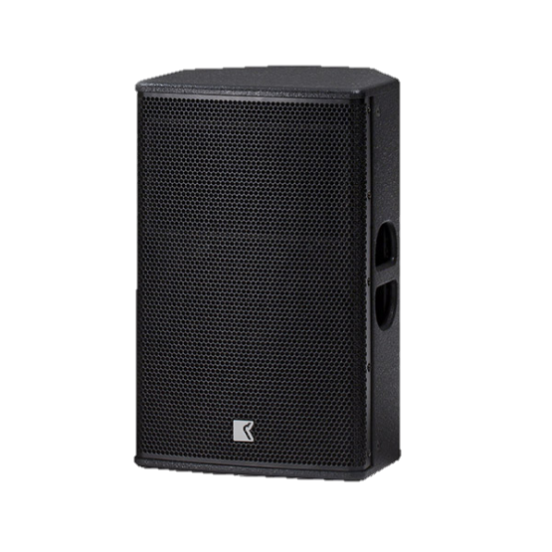
POINT SOURCE SPEAKER
DVS 12P iSP (Outline)
iMode와 통합된 2-way 바이 앰핑
티타늄 다이어프램이 일정한 지향성 혼조정 가능한 입력 게인
아이패드, 아이폰 등을 통해 제어 가능
SPECIFICATION
FREQUENCY RESPONSE(-10 dB) | 53 Hz - 20 kHz
AVERAGE DISPERSION | 90 ° x 50 °(H x V)
POWER AMPLIFIER | Type: Class D (digital) Input impedance: 10 kΩ balanced to ground Rated power: 2 x 750 W EIAJ on 4 Ω Cooling: temperature controlled variable speed fan Special feature: direct preset selection, controllable via iPad app
MAXIMUM SPL OUTPUT | 133 dB SPL
LOUDSPEAKERS AND LOADING | Low : 12″ woofer High: 3″ diaphragm compression driver
WEIGHT – SINGLE UNIT | 22.5 kg – 49.5 lb
DIMENSIONS | Height: 570 mm – 22 1/2″ Width: 350 mm – 13 3/3″ Depth: 350 mm – 13 3/4″

