Slide 1
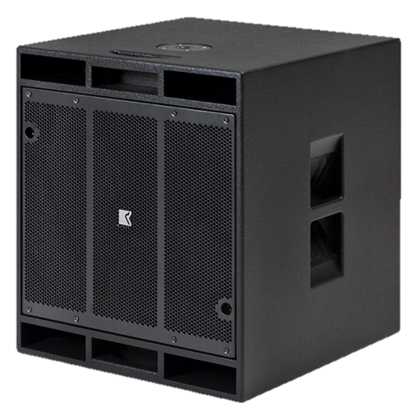
SUBWOOFER SPEAKER
DVS 118 SW iSP (Outline)
고효율 자체 전원 서브 우퍼
장시간 높은 음압을 안정적으로 전달
매우 높은 전력처리 및 최대 음압 레벨
iMode 이더넷 연결을 통해 모니터링과 제어
SPECIFICATION
Frequency Response (-10 dB) | 26 Hz – 118 Hz
Suggested Cross-Over | Max 150 Hz
Nominal Dispersion | Quasi-omnidirectional
Power Amplifier | Type: Class D (digital) Input impedance: 10 kΩ balanced to ground Rated power: 1500 W EIAJ on 8 Ω (bridged) Cooling: temperature controlled variable speed fan Special feature: controllable via iPad app
Maximum SPL Output * | 142 dB SPL
Component | 18″ woofer, vented high-pass box
Connectors | Audio: 1 XLR + 1 Link Out Ethernet: 1 EtherCon + 1 Link Out (RJ 45 Socket) Mains: 1 Powercon + 1 Link Out
Weight | 42 kg – 92.6 lb
DIMENSIONS | Height: 650 mm Width: 550 mm Depth: 600 mm

