Slide 1
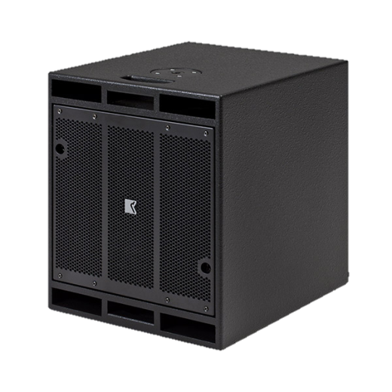
SUBWOOFER SPEAKER
DVS 115 SW iSP (Outline)
고효율 자가 전원 서브 우퍼
장시간 동안 높은 음압 유지 가능
매우 높은 전력 처리 및 최대 음압 레벨
이더넷 연결을 통한 모니터링 및 제어 가능
SPECIFICATION
Frequency Response (-10 dB) | 39 Hz – 147 Hz
Suggested Cross-Over | Max 150 Hz
Nominal Dispersion | Quasi-omnidirectional
Power Amplifier | Type: Class D (digital) Input impedance: 10 kΩ balanced to ground Rated power: 1000 W EIAJ on 8 Ω (bridged) Cooling: temperature controlled variable speed fan Special feature: controllable via iPad app
Maximum SPL Output * | 141 dB SPL
Component | 15″ woofer, vented high-pass box
Connectors | Audio: 1 XLR + 1 Link Out Ethernet: 1 EtherCon + 1 Link Out (RJ 45 Socket) Mains: 1 Powercon + 1 Link Out
Weight | 30.5 kg – 67.2 lb
DIMENSIONS | Height: 550 mm Width: 450 mm Depth: 550 mm

