Slide 1
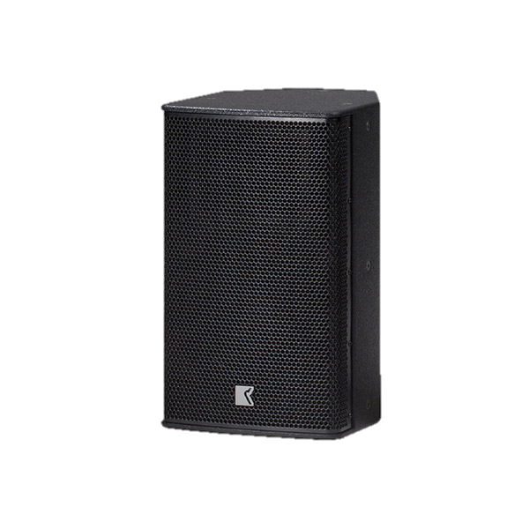
POINT SOURCE SPEAKER
DVS 10P SP (Outline)
다용도의 광범위한 자체 전원 시스템
내장 2 채널 DSP 제어 증폭기가 있는
2-way
조정 가능한 입력 게인
4개의 선택 가능한 EQ 프리셋
SPECIFICATION
FREQUENCY RESPONSE(-10 dB) | 48 Hz –18 kHz
AVERAGE DISPERSION | 80° x 60° (H x V)
POWER AMPLIFIER | Type: Class D (digital) Input impedance: 10 kΩ balanced to ground Rated power: 1 x 350 W EIAJ on 4 Ω (Low), 1 x 180 W EIAJ on 8 Ω (High) Cooling: natural air convection Special feature: selectable input gain and preset
MAXIMUM SPL OUTPUT | 131.5 dB SPL
LOUDSPEAKERS AND LOADING | Low : 10″ woofer High: 1.75″ diaphragm compression driver
WEIGHT – SINGLE UNIT | 13.5 kg – 29.8 lb
DIMENSIONS | Height: 500 mm – 19 5/8″ Width: 300 mm – 11 3/4″ Depth: 335 mm – 13 1/8″

