Slide 1
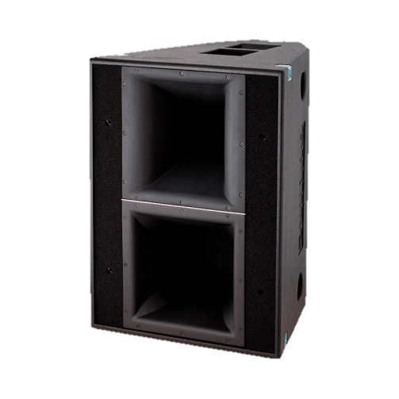
POINT SOURCE SPEAKER
DOPPIA II 9075 (Outline)
전용 디지털 프로세서를 통한 바이앰핑 또는 트라이앰핑 및 제어
400Hz~20kHz에서 +-50° 의 선형 위상 응답
내부 공명으로 인한 왜곡 방지를 위한 내부 강화
SPECIFICATION
FREQUENCY RESPONSE (-10 dB) | 60.5 Hz – 19.7 kHz
NOMINAL DISPERSION | 90° x 80° (H x V)
IMPEDANCE | Low: 8 Ω (min 8.5 Ω) Mid: 8 Ω (min 8 Ω) High: 16 Ω (min 10.8 Ω)
POWER – W AES | Low: 400 (1600 peak) Mid: 300 (1200 peak) High: 150 (600 peak)
MAX SHORT-TERM SPL @ 1 m* | 145.5 dB SPL
CONNECTORS (active version) | 2 x NL8 Speakon in parallel Low: pin 2+ (pos); pin 2- (neg) Mid: pin 1+ (pos); pin 1- (neg) High: pin 1+ (pos); pin 1- (neg)
LOUDSPEAKERS AND LOADING | Low: 2 x 12″ Hybrid loading Vented Box Mid: 1 x 10″ Wave Guide loaded High: 1 x 2″ Exit (3″ diaphragm), Wave Guide loaded
WEIGHT – SINGLE UNIT | 55 kg (121.3 lb)
DIMENSIONS | Height: 740 mm (29 1/8″) Width: 550 mm (21 21/32″) Depth: 600 mm (23 5/8″)

