Slide 1
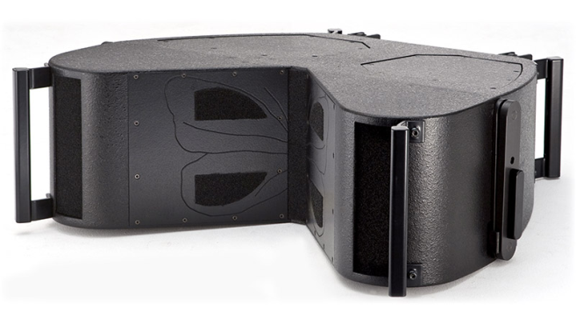
LINEARRAY SPEAKER
BUTTERFLY (Outline)
중저음, 중음 및 고음 재생을 위한 라인 어레이
작은 크기 대비 높은 SPL
DPRWG 웨이브 가이드
바이앰핑 3-way 시스템
SPECIFICATION
FREQUENCY RESPONSE (-10 dB) | 80 Hz – 18 kHz
AVERAGE DISPERSION | Horizontal: 90° Vertical: Depending on array configuration
IMPEDANCE | Low/Mid: 4 Ω (min 3.5 Ω) High: 8 Ω (min 8.3 Ω)
POWER – WAES | Low/Mid: 800 (3200 peak) High: 120 (480 peak)
MAX SHORT-TERM SPL @ 1 m, free-field* | 143 dB SPL
LOUDSPEAKERS AND LOADING | Low: 2 x 8″ bandpass loaded NdFeB woofers Mid: 2 x 8″ bandpass partially horn -loaded mid woofers High: 1 x 3″ diaphragm NdFeB compress-ion driver loaded by a D.P.R.W.G.
WEIGHT – SINGLE UNIT | 35 kg (77.2 lb)
DIMENSIONS | Height: 240 mm (9 7/16″) Width: 752 mm (29 19/32″) Depth: 600 mm (23 5/8″)

